Slide 1
Monthly Rainfall Prediction Using Wavelet Neural Network Analysis
TEAM MEMBERS:
JAGADEESH REDDY PANDHIKUNTA – 16326041
VENKATA SAIDEEP JAKKA- 16329410
AJAY PAVAN KUMAR REDDY GOPU – 16332139
YASWANTH GANDHAMUNENI -16327304

Slide 2
Table of contents
Abstract
Introduction
Objective
Problem Statement
Existing System
Proposed System and Advantages
Data Flow Diagram
Modules Description
System Architecture
Output
Conclusion
References

Slide 3
Abstract
One of the most important elements in a hydrological model is rainfall. To study and predict the rainfall forecast, several models have been developed. Wavelet approaches have been frequently used in water resources research in recent years due to their temporal frequency representation. By merging the wavelet methodology with Artificial Neural Networks, this research attempts to establish an alternate way for rainfall prediction (ANN).
Monthly rainfall data from the Darjeeling rain gauge station was used to test the wavelet and ANN models. The performance of the models in terms of calibration and validation is assessed using appropriate statistical approaches. The findings of monthly rainfall series modeling show that wavelet neural network models outperform ANN models in terms of effectiveness.

Slide 4
INTRODUCTION
In today's society, global warming is hurting people all over the world, having a tremendous impact on humanity and hastening climate change. As a result of this, the air and oceans are warming, sea levels are rising, and flooding and drought are becoming more common.
Rainfall is one of the most devastating repercussions of climate change. Rainfall forecast is a difficult task these days, and most of the major world authorities are taking it into consideration.
Rainfall is a climatic component that has an impact on a variety of human activities, including agricultural production, construction, power generation, and tourism. As a result, rainfall is a major concern, necessitating better rainfall forecasting.

Slide 5
Objective:
All existing algorithms were using plain satellite dataset to predict rainfall as this dataset may not contains present condition information so prediction may not be accurate.
To overcome this problem we are using wavelet digital signature dataset which contains present condition information so neural network can predict accurate rainfall.
Wavelet based prediction has gain lots of popularity due to signals contains present information.

Slide 6
Problem statement
Climate change is now the most pressing issue on the planet. People are trying to figure out how climate change affects the economy, from production to infrastructure. Predicting rainfall, like anything else, is a difficult undertaking that requires a high level of accuracy.
A poor rainfall forecast can have an impact on agriculture, particularly for framers, whose entire crop is dependent on rainfall, and agriculture is always an important element of any economy. As a result, developing a somewhat accurate rainfall prediction is possible. Machine learning techniques are utilized in a variety of ways, but accuracy is always a challenge when making rainfall predictions. Rainfall has a variety of effects on the earth, including drought, flooding, and extreme summer heat, to name a few.

Slide 7
Existing System:
Rainfall is a complex atmospheric process, which is space and time dependent and it is not easy to predict. Due to the apparent random characteristics of rainfall series, they are often described by a stochastic process.
Wavelet approaches have been frequently used in water resources research in recent years due to their time frequency representation.

Slide 8
Proposed System:
In this paper, the author uses a wavelet signal dataset to train a Multilayer Perceptron Neural Network that, when compared to existing techniques, can reliably predict rainfall. All existing algorithms used a simple satellite dataset to estimate rainfall, which may or may not incorporate current weather information, resulting in inaccurate predictions. To solve this challenge, the author is employing a wavelet digital signature dataset that contains current situation data such that a neural network can accurately predict rainfall. Because signals contain current information, wavelet-based prediction has gained a lot of traction.
Author is combing Wavelet data with neural network to predict rainfall so author has given algorithm name as WNN.

Slide 9
Advantages
Neural network can predict accurate rainfall.
Wavelet based prediction has gain lots of popularity due to signals contains present information.

Slide 10
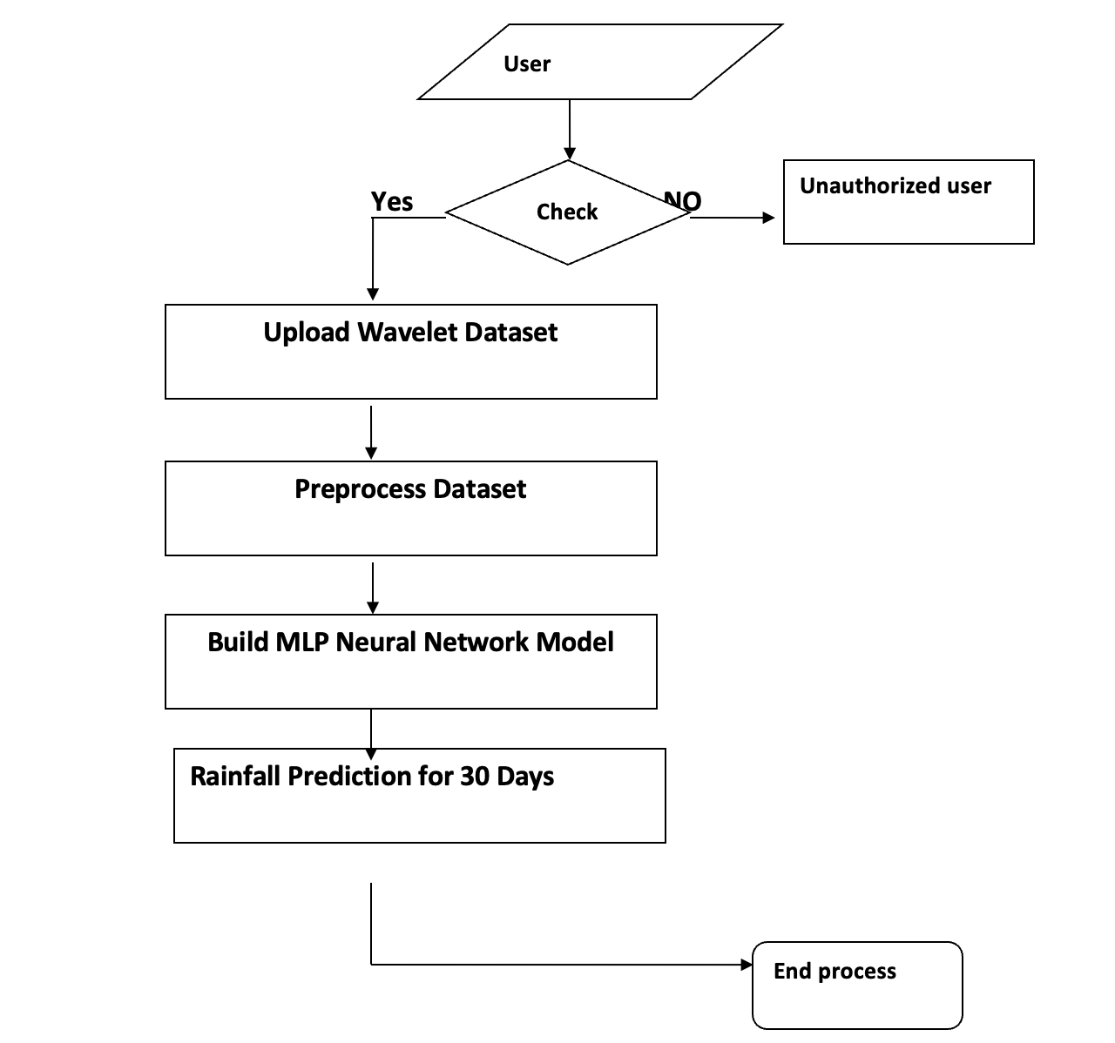
Data flow diagram

Slide 11
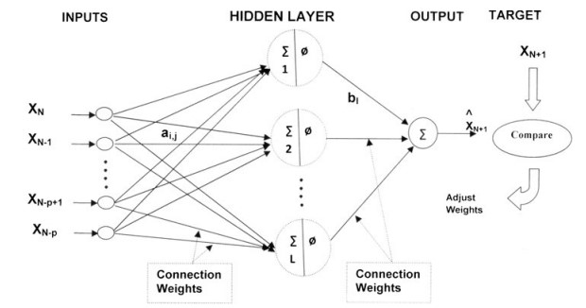
System Architecture

Slide 12
Modules
Upload Wavelet Dataset
Preprocess Dataset
Build MLP Neural Network Model
Rainfall Prediction for 30 Days

Slide 13
functionality Description
1.Data Collection
The dataset used in human speech emotion. And the composition of the dataset.understand the relationship among different features. A plot of the core features and the entire dataset.The dataset is further split into 2/3 for training and 1/3 for testing the algorithms. Furthermore, in order to obtain a representative sample, each class in the full dataset is represented in about the right proportion in both the training and testing datasets. The various proportions of the training and testing datasets used in the paper.
2.Data Preprocessing
The data which was collected might contain missing values that may lead to inconsistency. To gain better results data need to be preprocessed so as to improve the efficiency o the algorithm. The outliers have to be removed and also variable conversion need to be done. In order to overcoming these issues we use map function.
3.Model Selection
Machine learning is about predicting and recognizing patterns and generate suitable results after understanding them. ML algorithms study patterns in data and learn from them. An ML model will learn and improve on each attempt. To gauge the effectiveness of a model, it’s vital to split the data into training and test sets first. So before training our models, we split the data into Training set which was 70% of the whole dataset and Test set which was the remaining 30%. Then it was important to implement a selection of performance metrics to the predictions made by our model.
4.Predict the results
The designed system is tested with test set and the performance is assured. Evolution analysis refers to the description and model regularities or trends for objects whose behavior changes over time. Common metrics calculated from the confusion matrix are Precision; Accuracy. The mot important features since these features are to develop a predictive model using MLP model.

Slide 14
Python Libraries
NumPy: Base n-dimensional array package
SciPy: Fundamental library for scientific computing
Matplotlib: Comprehensive 2D/3D plotting
IPython: Enhanced interactive console
Sympy: Symbolic mathematics
Pandas: Data structures and analysis
Extensions or modules for SciPy care conventionally named SciKits

Slide 15
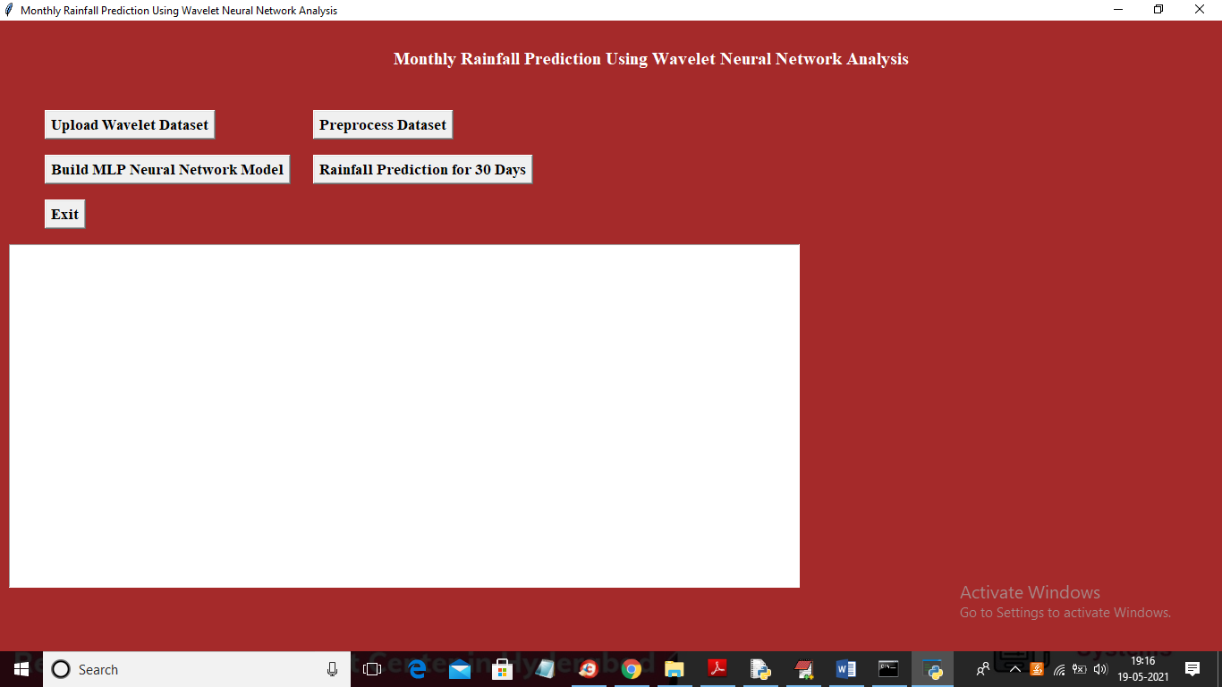
Output flow
In above screen click on ‘Upload Wavelet Dataset’ button to load dataset

Slide 16
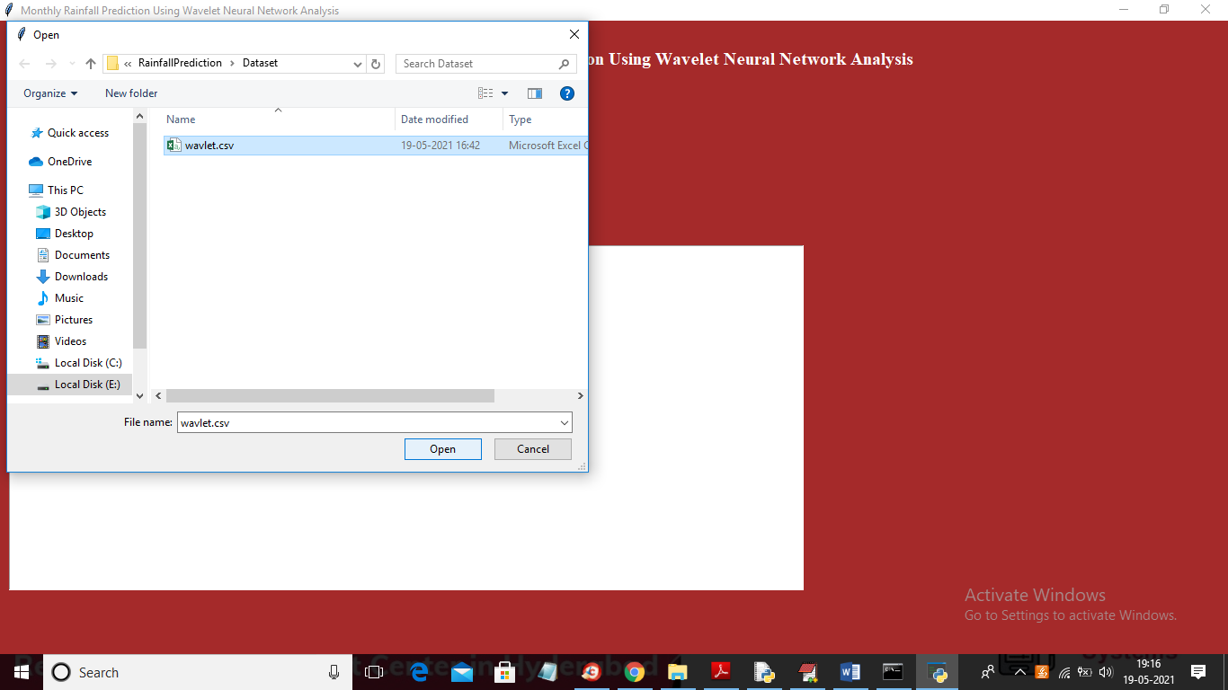
In above screen selecting and uploading ‘wavelet.csv’ file and then click on ‘Open’ button to load dataset and to get below screen

Slide 17
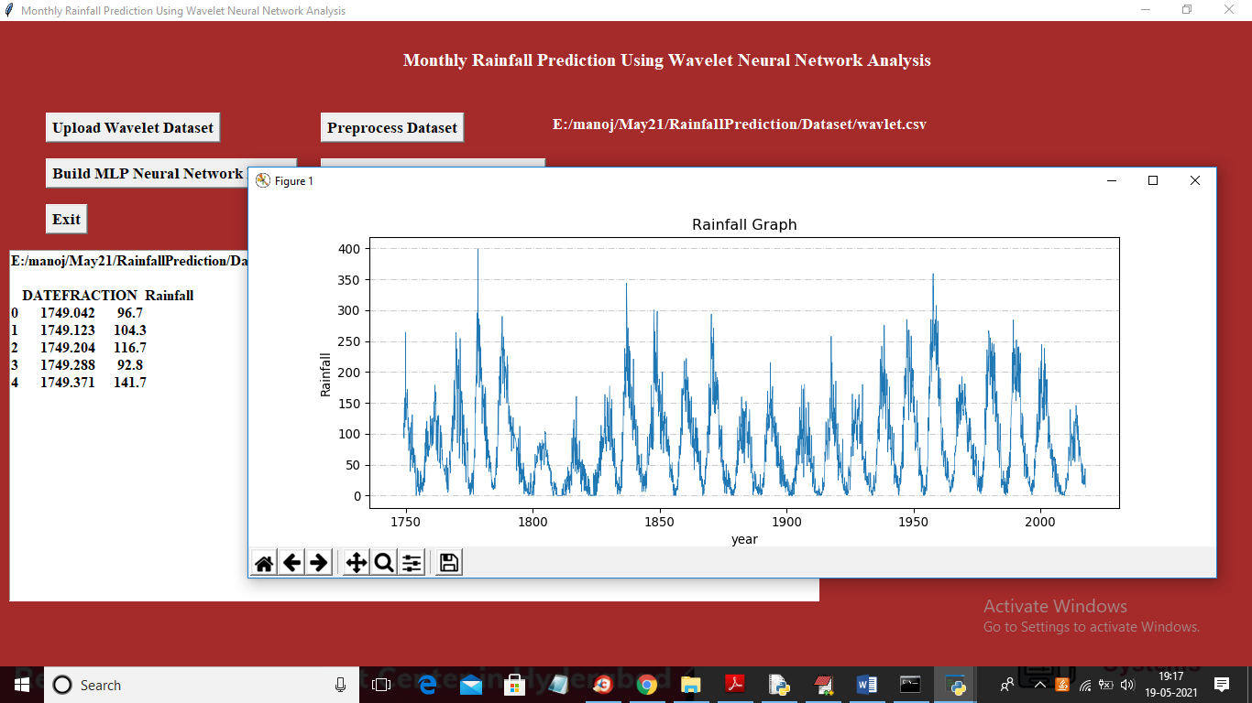
In above screen text area we can see year and rainfall from dataset and same thing we are plotting in graph where x-axis represents year and y-axis represents rainfall occurred in that year and now close above graph and then click on ‘Preprocess Dataset’ button to removing missing values and then split dataset into train and test part and then display wavelet rainfall graph from dataset like below screen

Slide 18
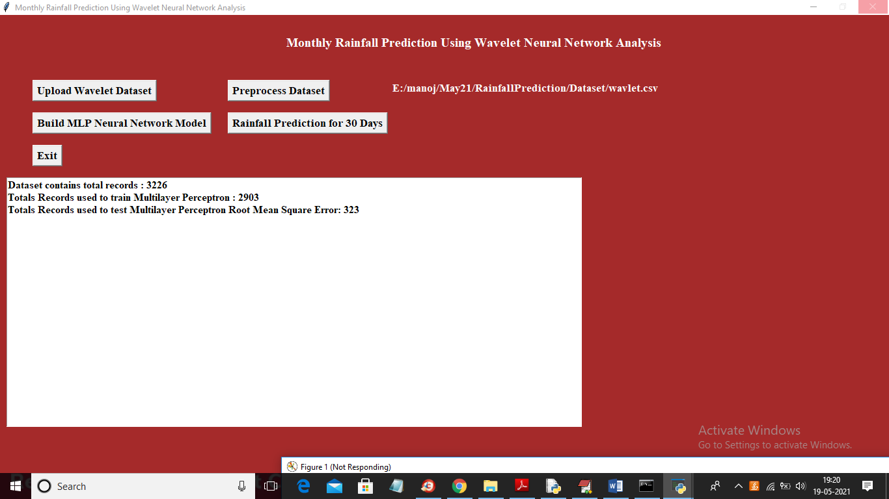
In above screen we can see dataset contains total 3226 records and application using 2903 (80%) records for training MLP and 323 records (20%) to test MLP prediction performance and then calculate RMSE (root mean square error). RMSE represents difference between actual and predicted values. If algorithm predict exact value then different will low and if predict wrong value then difference will be high

Slide 19
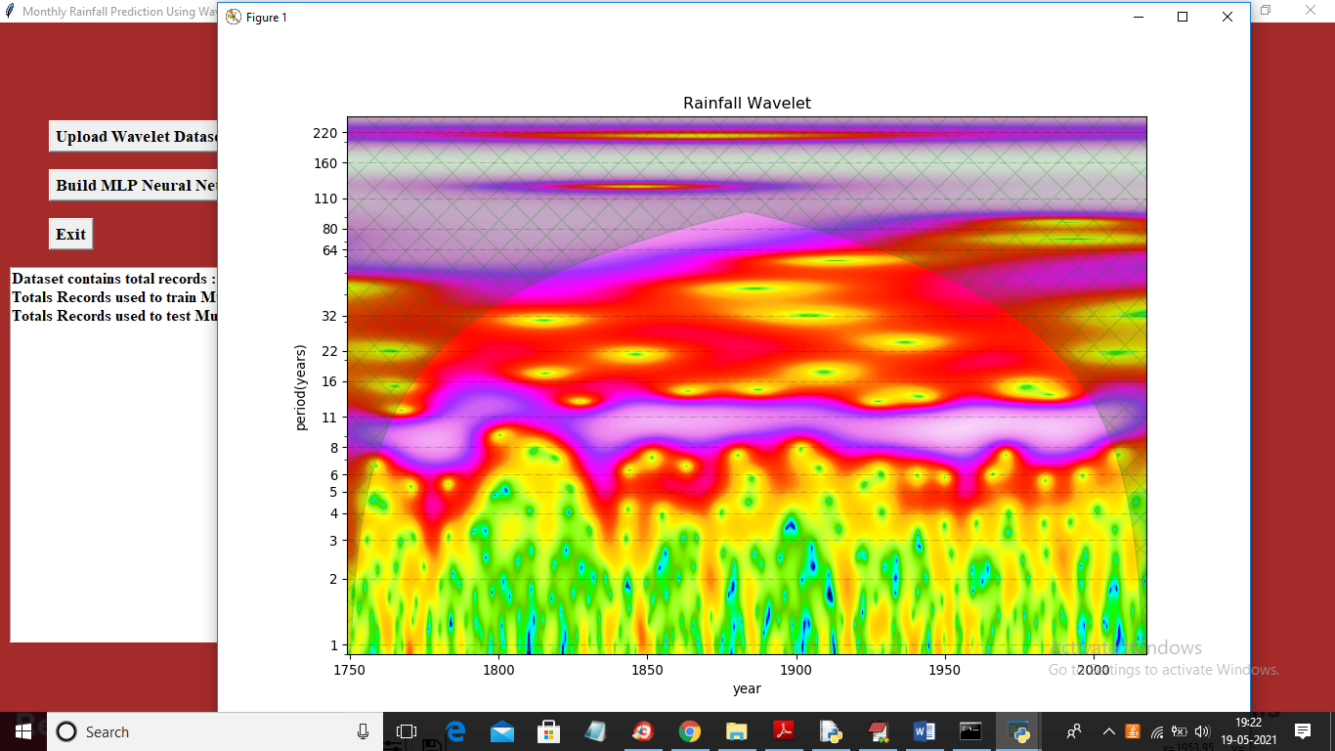
After preprocessing we got Wavelet rainfall graph where green dots represents rainfall and in above graph x-axis represents year and y-axis represents rate of receive rainfall.

Slide 20
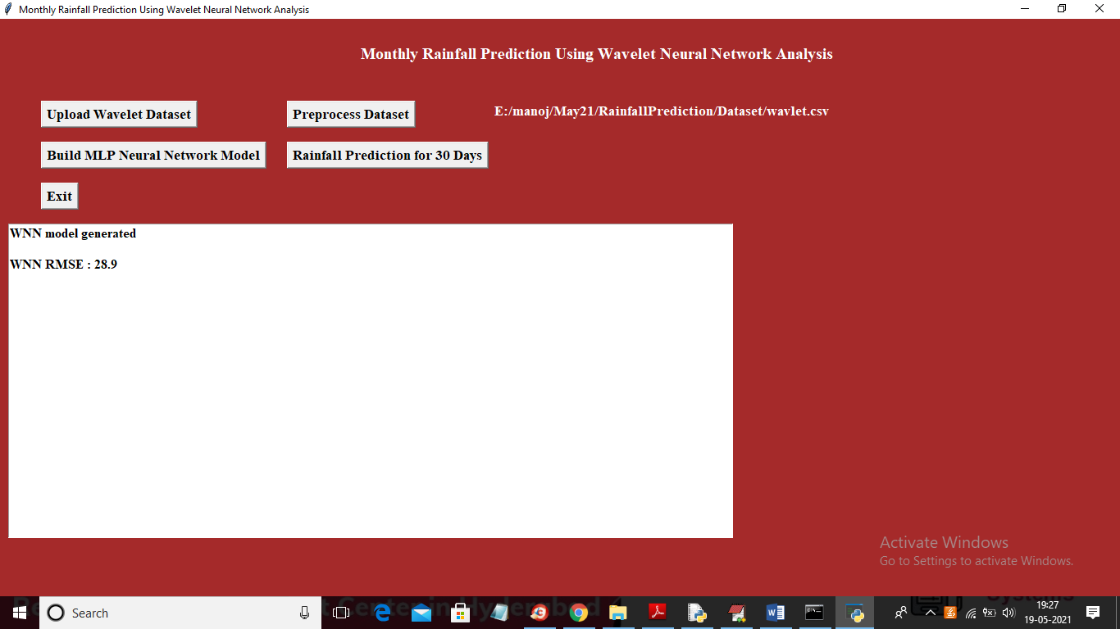
In above screen WNN model generated and we got RMSE error as 28% which is less than RMSE given in paper so model is accurate and now click on ‘Rainfall Prediction for 30 Days’ button to predict rainfall using WNN model

Slide 21
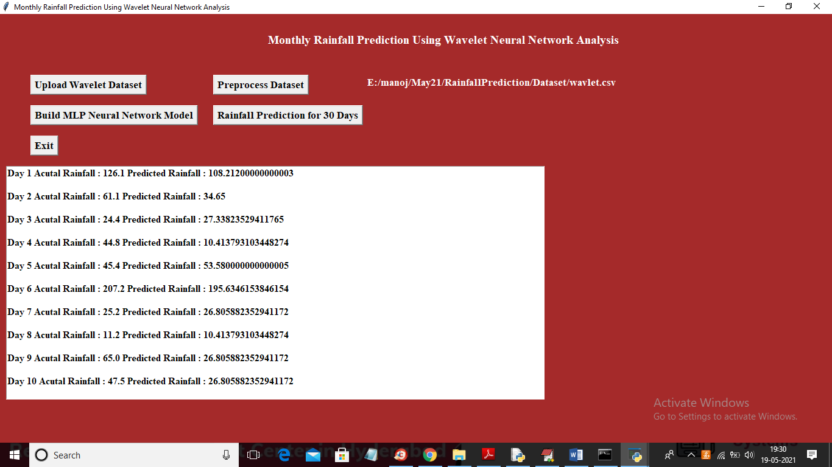
In above screen for each day we are printing actual rainfall from test data and predicted rainfall from WNN model and we can see difference between them is closed and you scroll down above text area to view all records

Slide 22

Screen
In above screen you can see for day 26, 27 and 28 prediction is closed to actual value and then will get below graph between actual and predicted rainfall

Slide 23
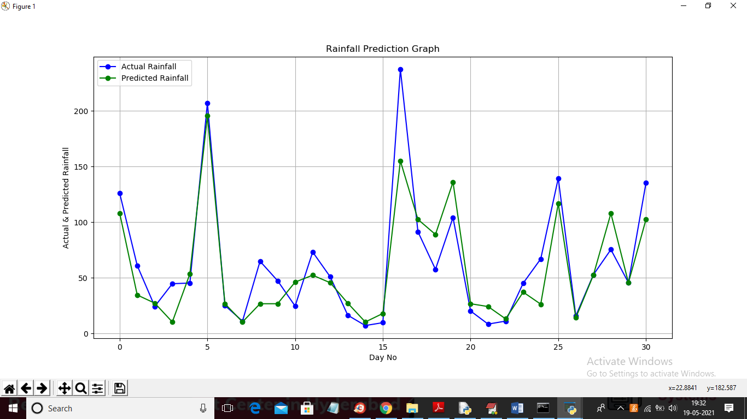
Screen
In above graph x-axis represents day and y-axis represents rainfall and in above graph blue line represents actual rainfall from test data and green line represents predicted rainfall and in above graph we can see difference between two lines are closed so we can conclude that prediction is accurate.

Slide 24
Conclusion
This paper reports a hybrid model called wavelet neural network model (WNN) for time series modeling of monthly rainfall. The proposed model is a combination of wavelet analysis and artificial neural network. Wavelet decomposes the time series into multilevel of details and it can adopt multiresolution analysis and effectively diagnose the main frequency component of the signal and abstract local information of the time series. The proposed WNN model has been applied to monthly rainfall of Darjeeling rain gauge station. The time series data of rainfall was decomposed into sub series by DWT. Appropriate sub-series of the variable used as inputs to the ANN model and original time series of the variable as output. Model parameters are calibrated using 44 years of data and rest of the data is used for model validation. From this analysis, it was found that efficiency index is more than 94 % for WNN models whereas it is 64 % for ANN models respectively. Overall analysis indicates that the performance of ANN are relatively lower compared to that of WNN models; this may be plausibly due to the variation in nonlinear dynamics of temperature which plays a predominant role in hilly areas included in rainfall process that mapped effectively by Wavelet based models. It may be noted that hydrological data used in the WNN model has been decomposed in details and approximation, which may lead to better capturing the rainfall processes. The study only used data from one rain gauge station and further studies using more rain gauges data from various areas may be required to strengthen these conclusions.

Slide 25
REFERENCE
Textbooks:
Programming Python, Mark Lutz
Head First Python, Paul Barry
Core Python Programming,R. Nageswara Rao
Learning with Python, Allen B. Downey
Journals:
Adamowski J, Sun K (2010) Development of a coupled wavelet transform and neural network method for flow forecasting of non-perennial rivers in semi-arid watersheds. J Hydrol 390(1–2):85–91
Anctil F, Tape DG (2004) An exploration of artificial neural network rainfall-runoff forecasting combined with wavelet decomposition. J Environ Eng Sci 3:121–128
Antonios A, Constantine EV (2003) Wavelet Exploratory Analysis of the FTSE ALL SHARE Index. In proceedings of the 2nd WSEAS international conference on non-linear analysis. Non-linear systems and Chaos, Athens
ASCE Task Committee (2000a) Artificial neural networks in hydrology-I: preliminary concepts. J Hydrol Eng 5(2):115–123 ASCE Task Committee (2000b) Artificial neural networks in hydrology-II: hydrologic applications. J Hydrol Eng 5(2):124–137
Aussem A, Murtagh F (1997) Combining neural network forecasts on wavelet transformed series. Connect Sci 9(1):113–121
Websites:
https://www.w3schools.com/python/
https://www.tutorialspoint.com/python/index.htm
https://www.javatpoint.com/python-tutorial
https://www.learnpython.org/
https://www.pythontutorial.net/

Slide 26
THANK YOU

